Slide 1
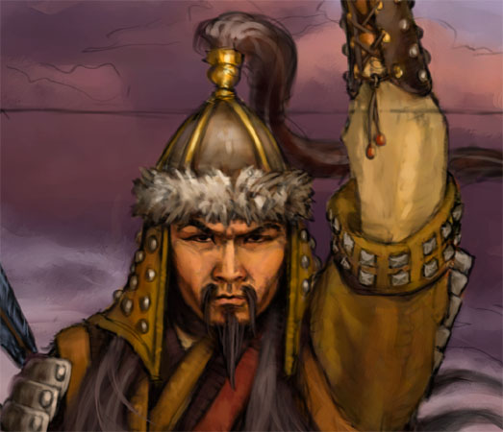
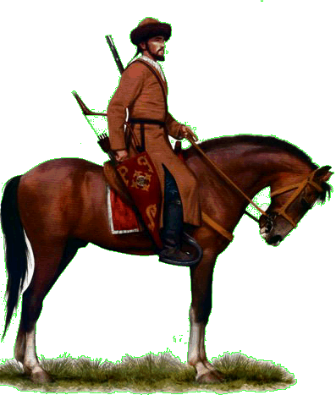
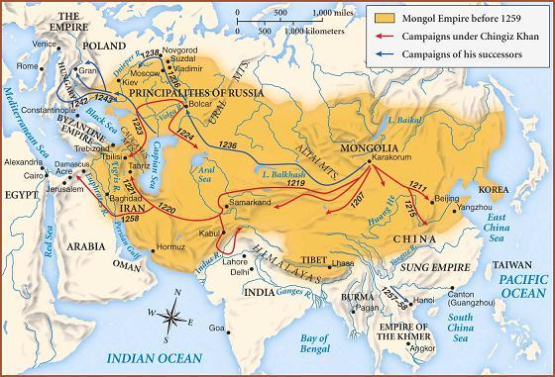
The Mongol and Ming Empires:
Mongols came from the Steppes of Asia:
Were separate warring tribes
United by Genghis Khan
Genghis Khan conquered a huge empire: Pacific Ocean (China) to E. Europe
Steppes – vast, treeless plains of Central Asia

Slide 2
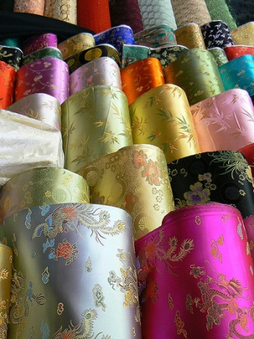
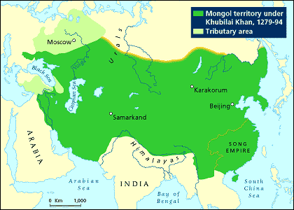
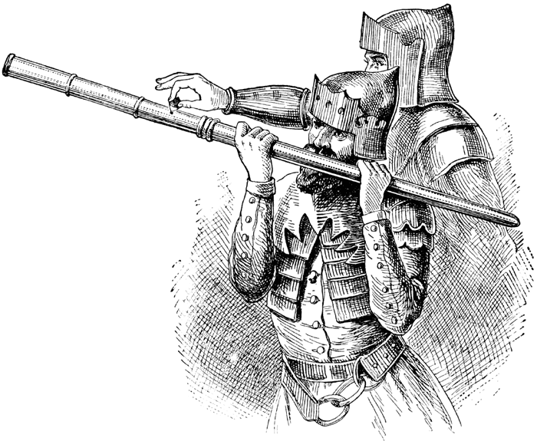
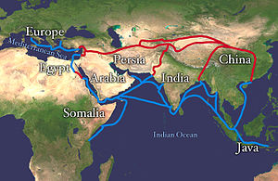
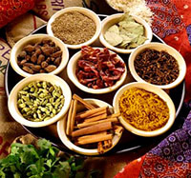
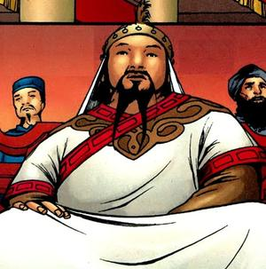
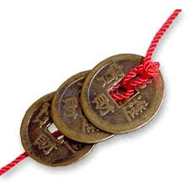
Mongols invade China
Used missiles loaded into
metal tubes
Dominated
Asia For
150 years
Mongolian Hand cannon
Contact & trade w/ Europe & Asia thrived

Slide 3
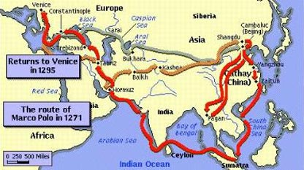
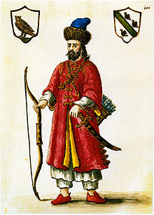
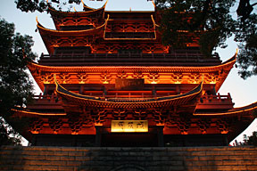
China was called “Cathay” at that time (you will see this on old maps)
Italian Merchant, Marco Polo, visits China – 1271
He spent 17 yrs there
Wrote about travels
Described royal palaces, royal mail system, good roads, etc.
Reported city of Hangzhou = 10-12 times size of Venice

Slide 4
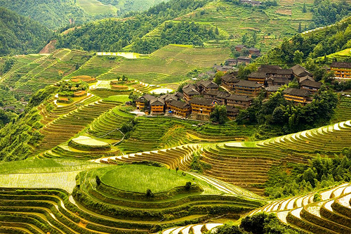
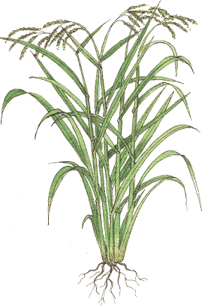
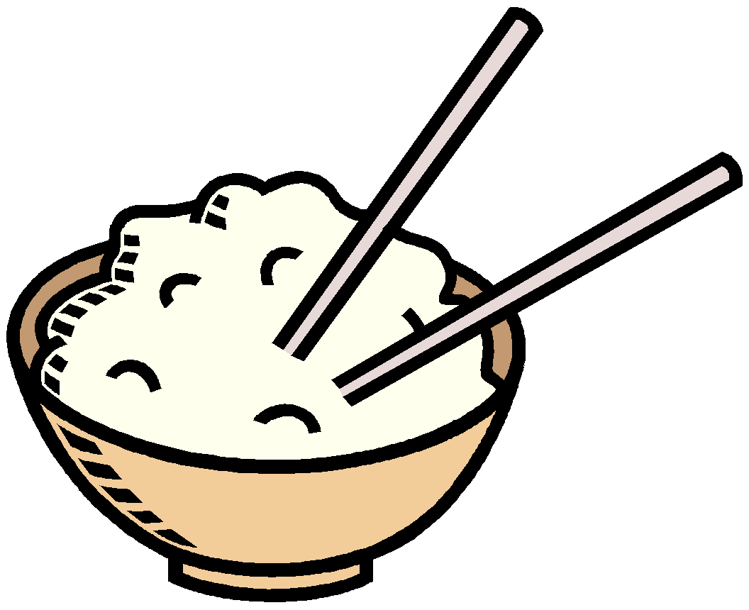
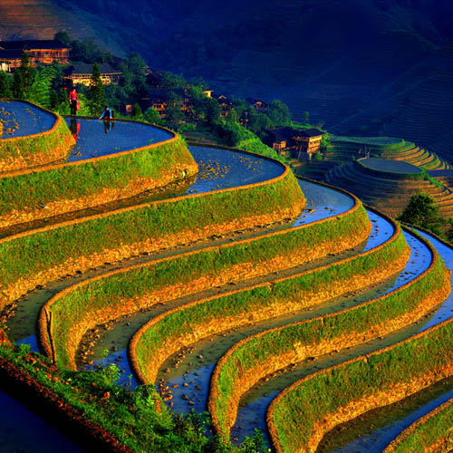
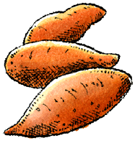
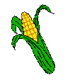
Ming Restore Chinese Rule
1368 – founding of Ming Dynasty
Ming means “brilliant”
New farming methods increased food production:
Rice, corn, sweet potatoes
Terracing improves & increases growing area:
Cutting horizontal steps into steep hillsides

Slide 5
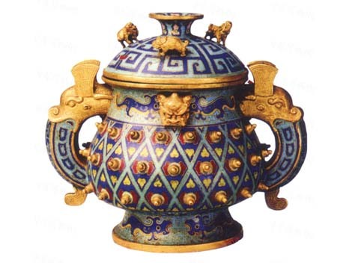
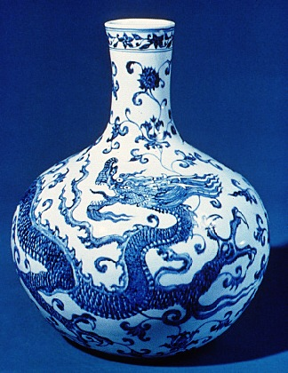
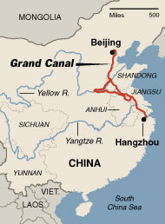
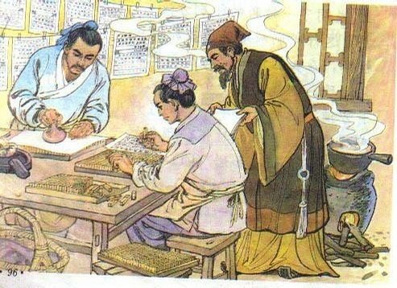
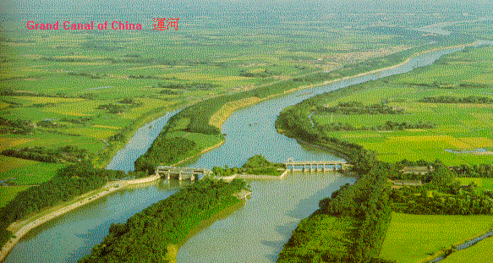
Ming Restore Chinese Rule
Industries:
Porcelain, paper, tools
Good Canal Transport System
Grand Canal / moves goods
New Technologies:
better printing = flood of books = inexpensive = reading by common people increased
Ming Vases
highly valued & VERY expensive!
Exported to West
Collected even today

Slide 6
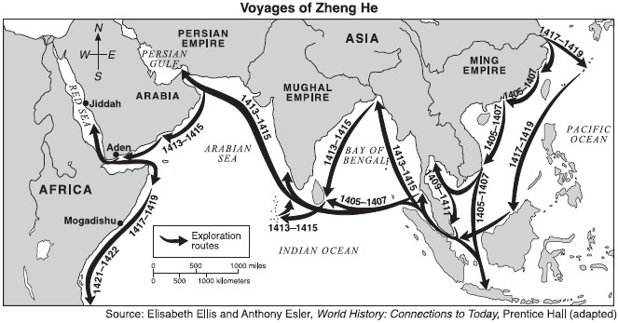
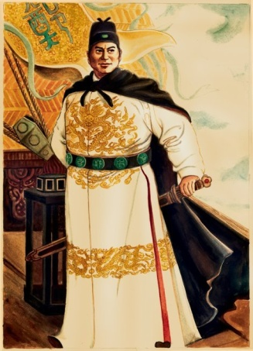
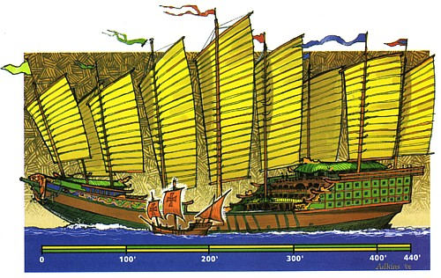
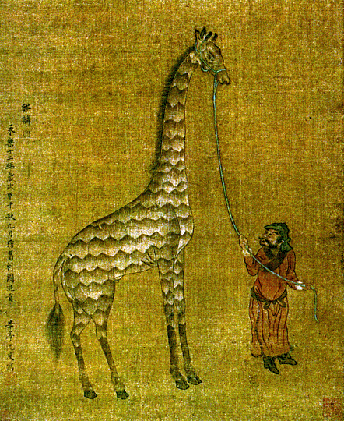
Zheng He and His Fleets
1405 – 1433 – Zheng He commanded 7 expeditions
62 huge ships, over 400 ft. long!
Had a 40 ft rudder
200 smaller ships
28,000 sailors
Explored: coast of SE
Asia, India, Red Sea
& Persian Gulf, E. Africa
Set up permanent
trading centers
Exotic imports, like
giraffes, sent to China
World learned of power
of Chinese Emperors
Zheng He’s ship compared
to Columbus’ ship

Slide 7
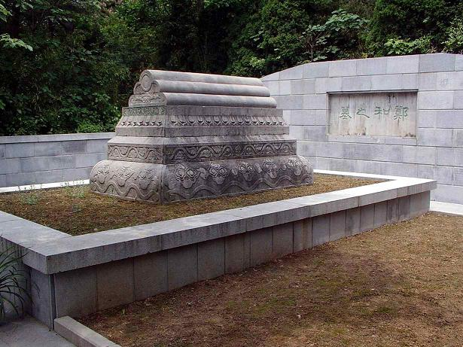
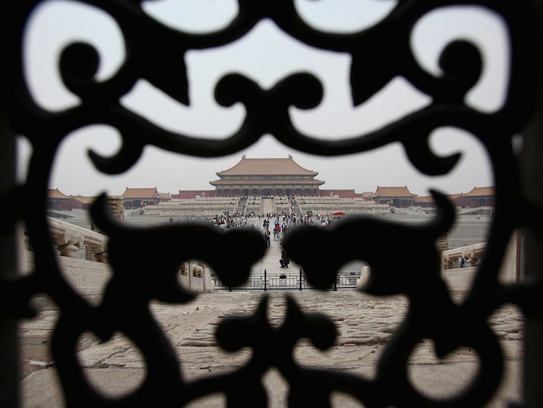
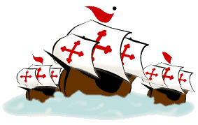
Exploration Ends
1435 – Zheng He died
Ming emperor suddenly banned building of seagoing ships
Why turn back on exploration?
Too costly?
Against Confucianism?
Preserve traditions?
60 years later Columbus begins exploration
What might have happened if China had continued exploring?
Zheng He’s grave
Ming Dynasty closes its doors to the world

